Slide 1
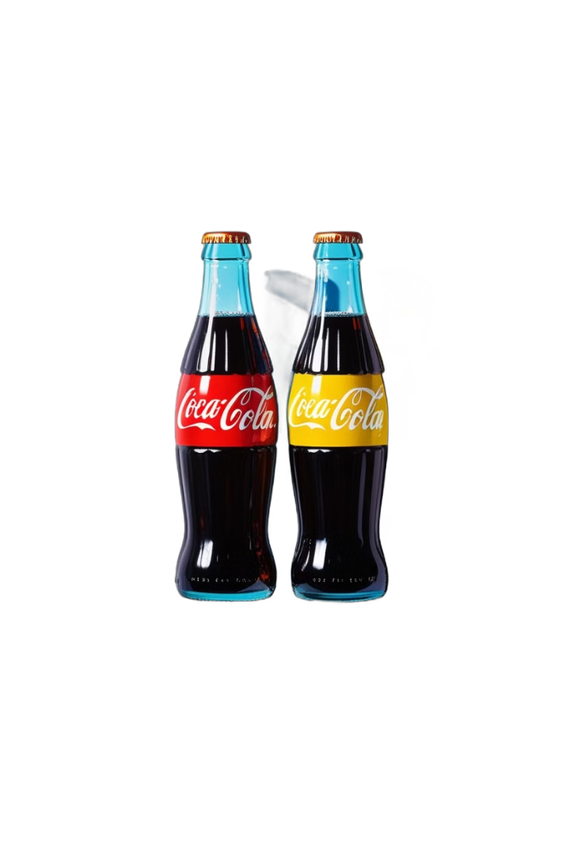
Predictive Maintenance Analysis for Swire Coca-Cola
Group 2
Richard Lim, Ketki Kulkarni, Anusha Vivekanand, Vedika Garg
Notes:
Richard Lim: 1,2,3,8Ketki: 10,11,12Vedika:4,5,9Anusha:6,7,9

Slide 2
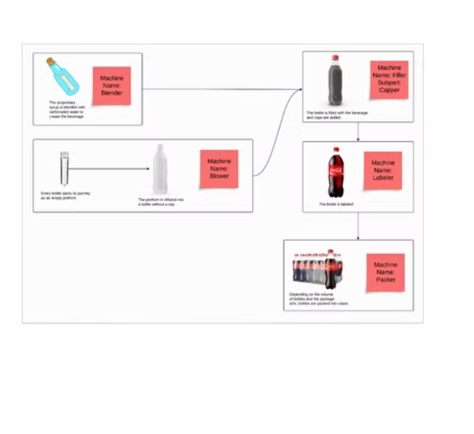
Background
Our capstone project focuses on identify and analyze breakdown patterns in machine downtime, and find major factors influencing breakdowns using IWC dataset across the 6 plants in worldwide.
The goal is to understand the breakdown frequency, timing, and locations, as well as the root causes and possible resolutions.

Slide 3


Objective
Analytical Goal
Business Goal
Develop a predictive model to forecast machine downtime frequency and duration.
Provide actionable items for proactive maintenance, cost reduction, and efficiency improvement.

Slide 4

Assumptions
Predictable Pattern
Machine failure patterns are consistent and predictable across equipment types and plant location.
Preventive repair
Equipment parts causing downtime can be pre-stocked for timely repairs.
Limitations
Unrecorded IWC Tracking
Only significant breakdowns are recorded, potentially missing patterns from less severe issues.
Large Missing Data
Some work orders have over 70% missing data, impacting analysis accuracy.
Unidentified Machine Age
Machine age and usage patterns may not be suitable for model development, affecting prediction accuracy.

Slide 5
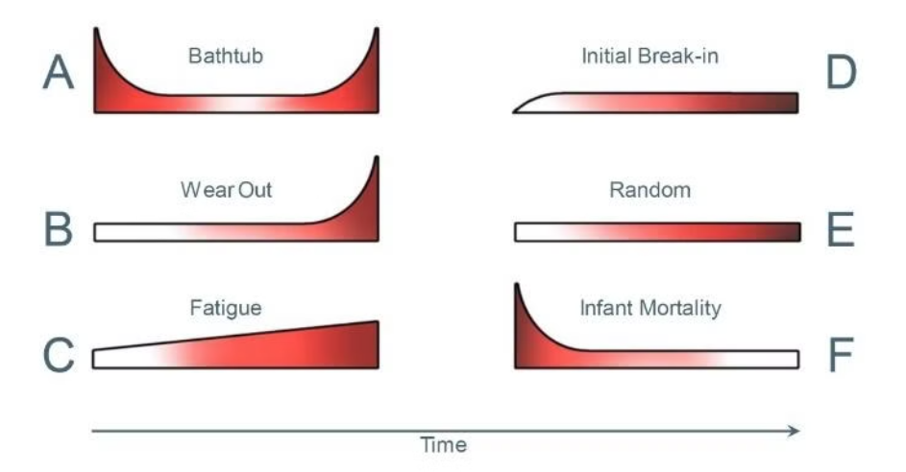
Dataset Overview
The dataset contains 1,427,264 rows and 27 columns. Each row represents a work order recorded by IWC.

Slide 6
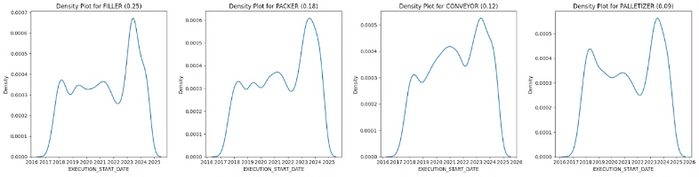
EDA
Top 4 Unplanned Equipments Breakdown [FUNCTIONAL_AREA_NODE_4_MODIFIED]
It Consists of 64% of total unplanned breakdowns [FILLER] [PACKER] [CONVEYOR][PALLETIZER]
Takeaways There are certain breakdown patterns per plant location in that we are collecting unplanned equipment breakdown data only.([FILLER] [PACKER] [CONVEYOR][PALLETIZER]). For example, SILVERSTONE shows the consistent pattern as a (A) bathhub, which requires improving quality control to reduce early-life failures and designing for durability to extend the useful life.​

Slide 7
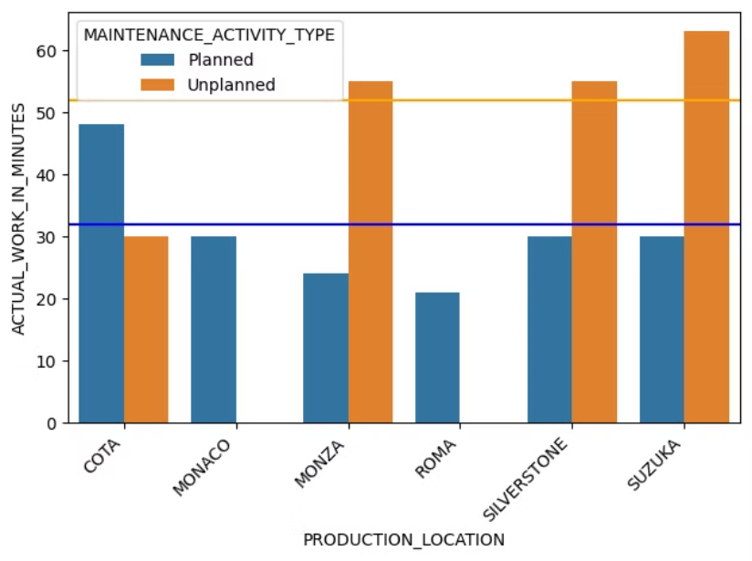
Analysis Metrics
50.0
32.0
36%
Unplanned
Planned
Reduction
Minutes (Median)
Minutes (Median)
Potential for improvement

Slide 8
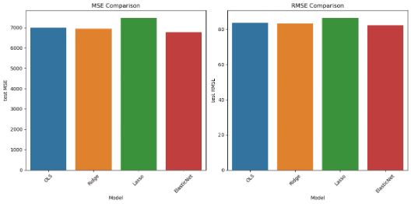
Modeling & Evaluation
Regression Model
Data preprocessing
Group by given data with [df['PLANT_ID'] + '-' + df['LINE_ID'] + '-' + df['SUBPROCESS_ID'] and predict when is the next breakdown duration based on historical data.
The model comparison provides valuable insights into performance across different regression approaches.
Model
RMSE
MSE
R-squared
OLS
83.6577
6998.6032
0.6086
Ridge
83.2756
6934.8299
0.6122
Lasso
86.3950
7464.0931
0.5826
Elastic-Net
82.2674
6767.9204
0.6215
Takeaways
The ElasticNet model stands out, achieving the lowest test RMSE (82.27) and MSE (6767.92), suggesting it strikes the best balance between bias and variance, making it highly suitable for predicting maintenance outcomes.

Slide 9
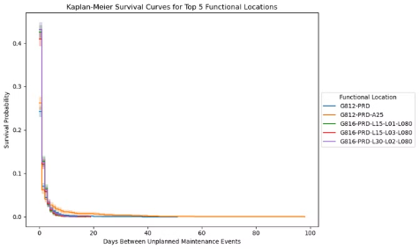
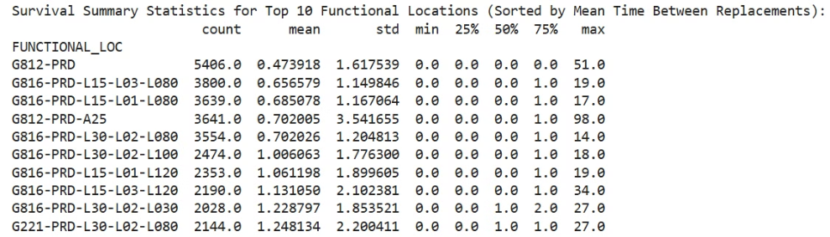
Modeling & Evaluation
Survival Analysis
The equipment threshold production capacity defines how much equipment can be maintained until the machine is working at full capacity before needing maintenance.
Analyze time between equipment failures across functional locations [FUNCTIONAL_LOC]
Takeaways An equipment in Plant Location : Roma (G812) would fail on average at 0.47 days, Cota (G816) in 0.65 days and Suzuka (G221) at 1.24 days.

Slide 10
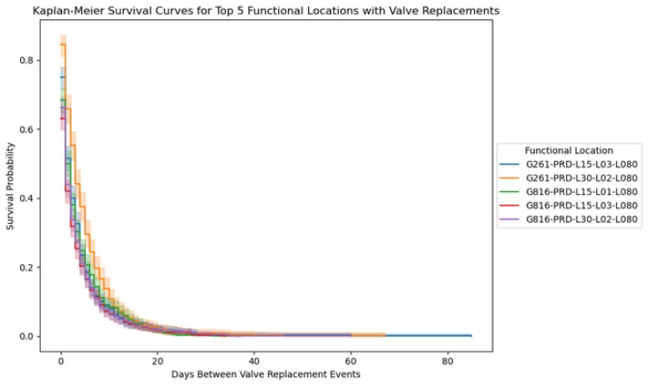
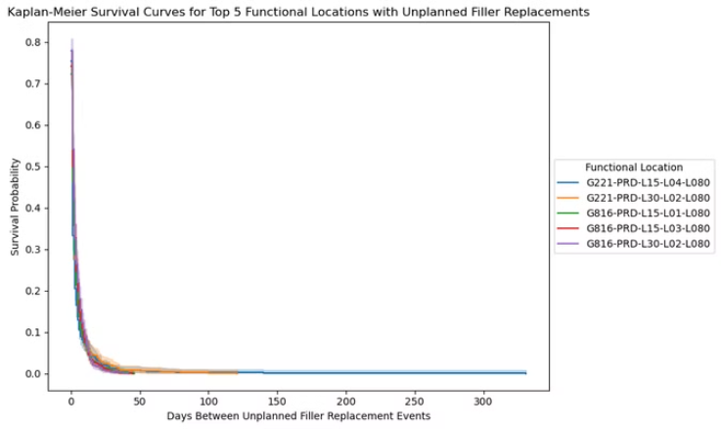
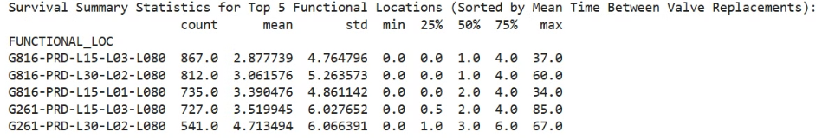
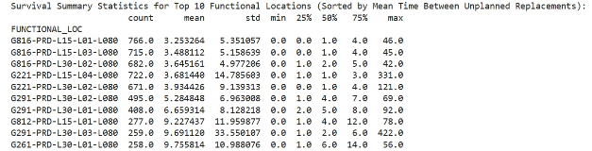
Survival Analysis
Survival Summary Statistics for Top 5 Functional Locations

Slide 11

Analytical Interpretation
1
Survival Analysis
Survival probabilities drop sharply within the first few days after maintenance in key locations like Suzuka, Sliverstone and Monza.
2
Component-Level Insights
Our analysis shows that fillers, packers, conveyers and palletizers were the most parts identified with frequent breakdowns.
3
Regression Models
Regression models provides the stability of modeling for predicting the last breakdown duration with 0.6 R-squared correlation across multiple models such as OLS, ridge, lasso and elastic-net.
4
Risk Prioritization
The analysis helps rank functional locations by their maintenance needs, allowing for precise allocation of resources.

Slide 12

Business Interpretation
1
Operational Efficiency
Proactive maintenance reduces downtime, ensuring smooth production cycles and safeguarding revenue.
2
Cost Reduction
Predictive maintenance minimizes repairs and replacements, cut the labour cost leading to cost savings in maintenance budgets.
3
Strategic Resource Allocation
Prioritizing high-risk locations optimizes resource allocation, ensuring critical parts are readily available.
4
Lean Inventory Management
Insights into high-demand parts enable better inventory planning, reducing overstocking and minimizing repair delays.

Slide 13

Call to Action
1
Pilot Program
We recommend piloting this strategy at high-risk locations to quantify its impact.
2
Scalability Measurement
Once validated, the strategy can be scaled across Swire's operations.
3
Operational Roadmap
This is not a one-time solution, but a roadmap to establish operational excellence.

Slide 14
Questions & Answers

